Slide 1


A SHIP ON A MOONLIT NIGHT

Slide 2

Presented by:
Md. Saiful Islam Santo
2125051047
6A2
Md. Fudail
2125051014
6A1
Course:
Computer Graphics and Multimedia Lab
CSE 358
Submitted to:
Ms. Sonia Afroz
Lecturer dept. of CSE, UITS
Ms. Adiba Akter Setu
Lecturer dept. of CSE, UITS

Slide 3

Objects
Ship
Mountains
Moon
Ocean
Stars
Sky
Clouds

Slide 4
Introduction
Welcome to our presentation on "A Ship in a Moonlight Night" where we'll explore the development process of our C++ graphics project. This project aims to create a captivating night time scene using procedural generation and graphics techniques.
We tried to focus on the visual depiction of a ship in a moonlit night, highlighting the various objects and elements that will be gradually introduced and developed over the course of the presentation.

Slide 5
Week 01: Topic Discussion and Analysis
Discussing the Theme
In the initial week, we discussed the concept and requirements of the project. We analyzed various graphics techniques and decided on the objects to include in our scene.
Analyzing Visuals
They will closely examine reference images of ships, oceans, skies, and moonlit landscapes to inform the visual direction and aesthetic of the presentation.
Brainstorming Ideas
Through collaborative ideation sessions, we generated a wealth of creative concepts and narrative ideas to bring this evocative scene to life.

Slide 6
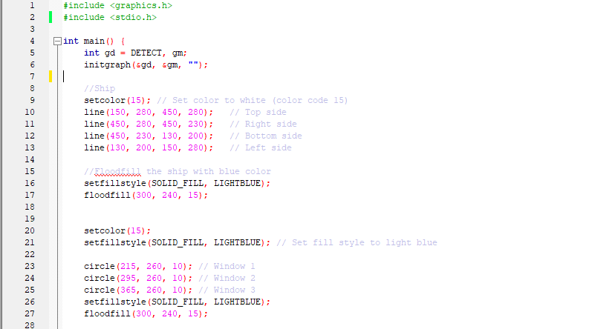
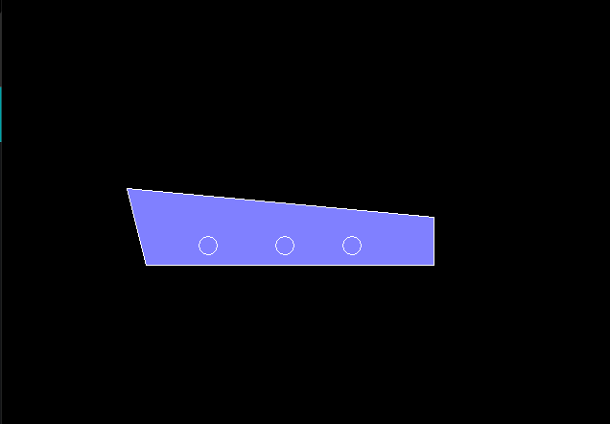
Week 02: Ship Shape
During the second week, we focused on creating the ship object and ensuring its shape and design fit well within our scene.

Slide 7
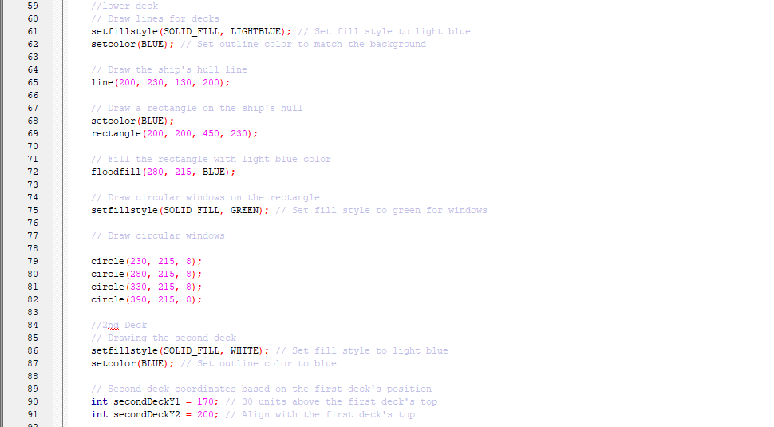
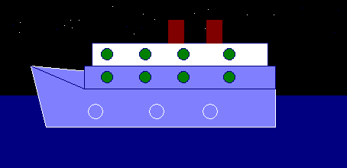
Week 03: Ship Shape and Background Ocean Using C++ Code
In the third week, we implemented the background ocean using C++ code. We incorporated realistic ocean patterns and adjusted the ship's position accordingly.

Slide 8
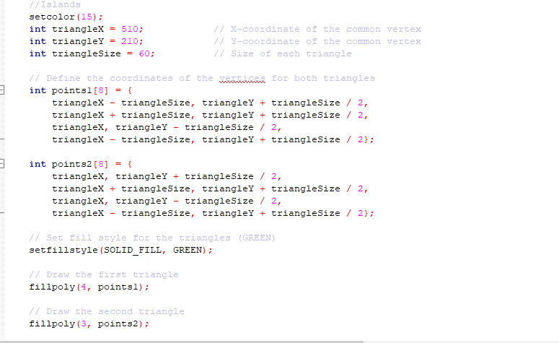
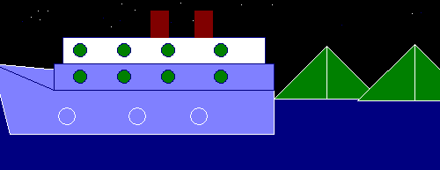
Week 04: Mountains
Week four was dedicated to creating the mountain landscape. We experimented with different mountain shapes and textures to achieve a visually appealing backdrop.

Slide 9
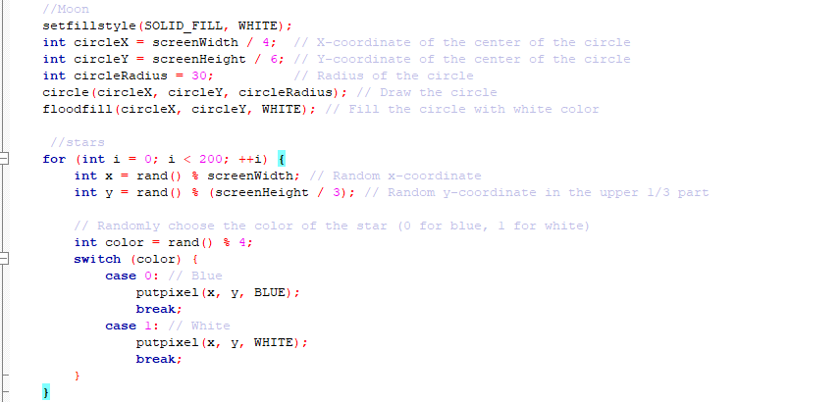
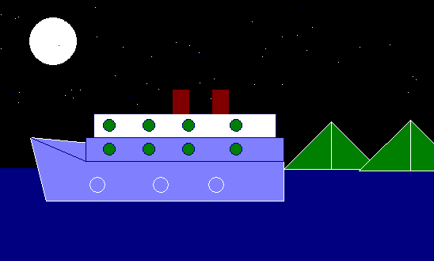
Week 05: Added Moon and Stars
During the fifth week, we introduced the moon and stars to our scene. We implemented dynamic lighting effects to simulate the moon's glow and scattered stars across the sky.

Slide 10
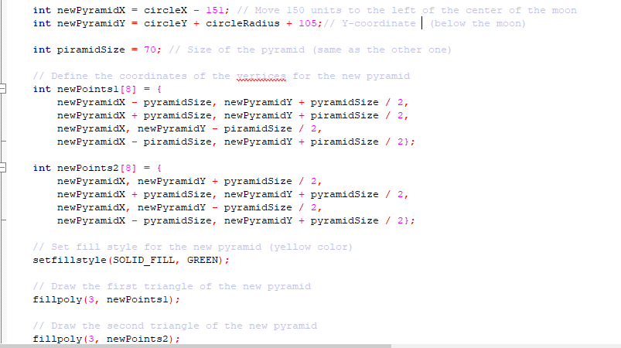
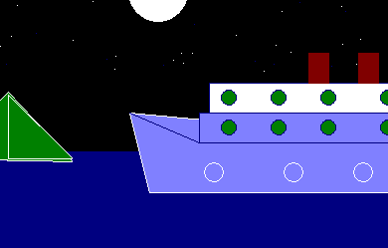
Week 06: Added More Moutains
In week six, we expanded the mountain range to enhance the depth and realism of our scene. We adjusted the placement and size of the mountains to create a sense of scale.

Slide 11
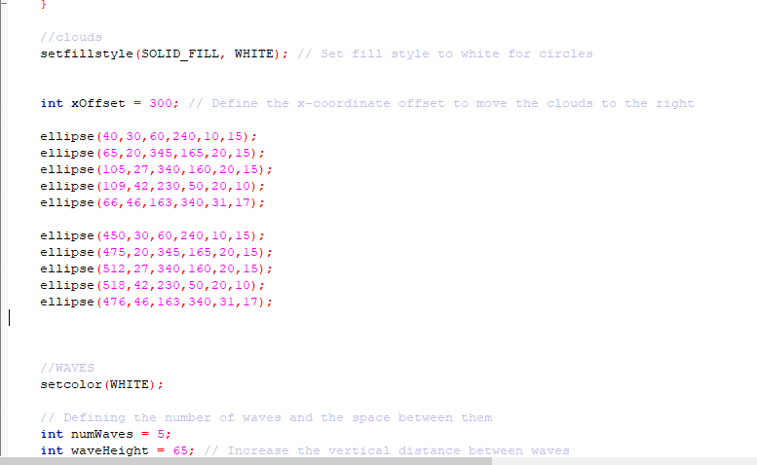
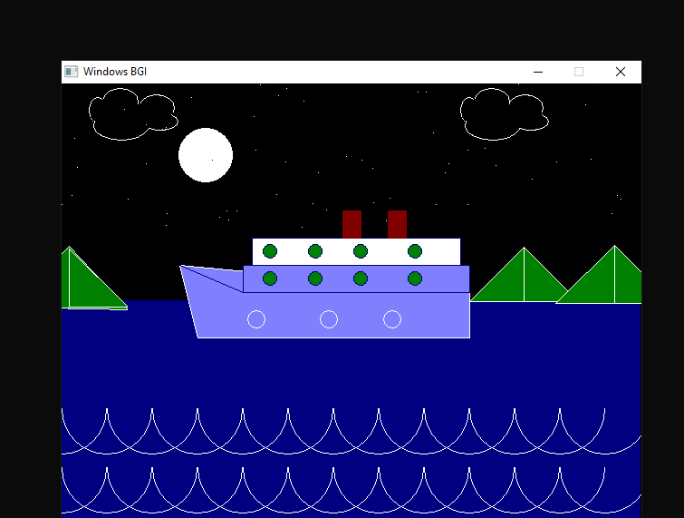
Week 07: Clouds and Waves
The seventh week involved adding clouds and refining the wave patterns in the ocean. We utilized procedural generation techniques to generate realistic cloud formations and adjusted the wave parameters for a more dynamic ocean effect.

Slide 12


Conclusion:
As we look to the future, we aim to further refine our scene and explore additional graphics techniques. Collaboration with our audience is essential; their insights and feedback will guide us on this journey of continuous improvement. Together, we'll embark on a realistic exploration, grounded in the principles of craftsmanship and creativity.

Slide 13
Resource Page
Here are some additional resources and inspiration for
the graphics project:
Google
Youtube
Github
Google photos

Slide 14


THANK YOU!
FOR YOUR ATTENTION

Slide 15

ANY QUESTIONS?

